Slide 1


Java + Hibernate
ORM (Object Relational Mapping): Database Lab
A hands-on lab for connecting Java applications with relational databases using Hibernate ORM framework.
โดย Sarawoot Kongyoung

Slide 2

Lab Title
Java + Hibernate ORM
Practical Focus
Connecting Java with Relational Databases
Hands-on database integration
ORM Approach
Object-Relational Mapping techniques

Slide 3




What is Hibernate?
Java-based ORM framework
Maps Java classes to database tables
Simplifies database operations

Slide 4





Why Use ORM?
Avoid Boilerplate
Eliminates repetitive JDBC code
Object Focus
Work with Java objects, not SQL
Schema Mapping
Automatic table-class conversion
Relationships
Supports 1:1, 1:N connections

Slide 5
import java.sql.*;
public class PostgresJDBCExample {
public static void main(String[] args) {
String url = "jdbc:postgresql://localhost:5432/your_database";
String user = "your_username";
String password = "your_password";
try (Connection conn = DriverManager.getConnection(url, user, password)) {
System.out.println("✅ Connected to PostgreSQL!");
// Insert an employee
String insertSQL = "INSERT INTO employee (name, department, position, start_date) VALUES (?, ?, ?, ?)";
try (PreparedStatement pstmt = conn.prepareStatement(insertSQL)) {
pstmt.setString(1, "Nok");
pstmt.setString(2, "IT");
pstmt.setString(3, "Developer");
pstmt.setDate(4, Date.valueOf("2025-04-01"));
pstmt.executeUpdate();
System.out.println("✅ Employee inserted");
}
// Query all employees
String querySQL = "SELECT * FROM employee";
try (Statement stmt = conn.createStatement();
ResultSet rs = stmt.executeQuery(querySQL)) {
while (rs.next()) {
System.out.printf("👤 ID: %d | Name: %s | Dept: %s | Pos: %s | Start: %s%n",
rs.getInt("emp_id"),
rs.getString("name"),
rs.getString("department"),
rs.getString("position"),
rs.getDate("start_date"));
}
}
} catch (SQLException e) {
e.printStackTrace();
}
}
}

Slide 6
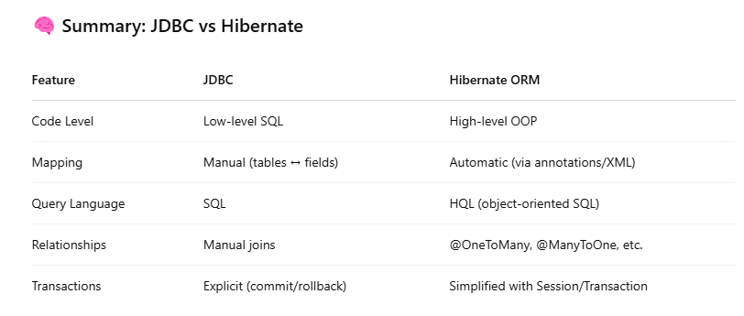

Slide 7










Hibernate Architecture
Configuration
Setup and properties
SessionFactory
Creates Session instances
Session
Manages connections
Transaction
ACID operations
HQL
Query language

Slide 8





Setup Requirements
JDK 17+
IDE
Maven
Latest Java Development Kit
Eclipse or VS Code
Dependency management
Database
MySQL or SQLite

Slide 9

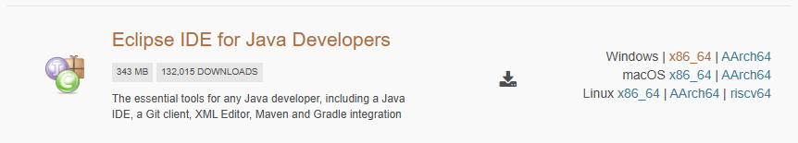
Install Eclipse
Install
Select Package
Extract and launch the application
Download
Choose "Eclipse IDE for Java Developers"
Get Eclipse from eclipse.org/downloads

Slide 10
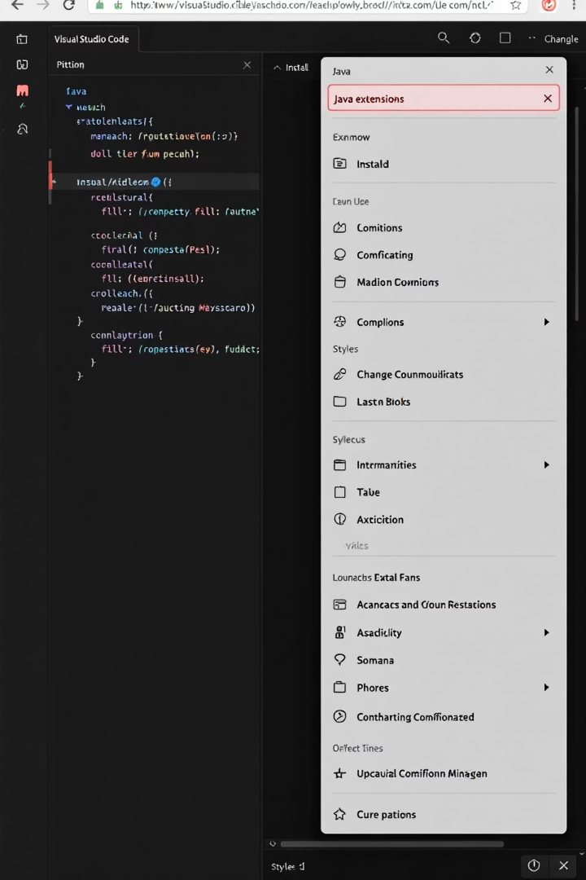



Install VS Code (Optional)
Download VS Code
From code.visualstudio.com
Install Extensions
Add Java Extension Pack
Configure
Set up Java path in settings

Slide 11
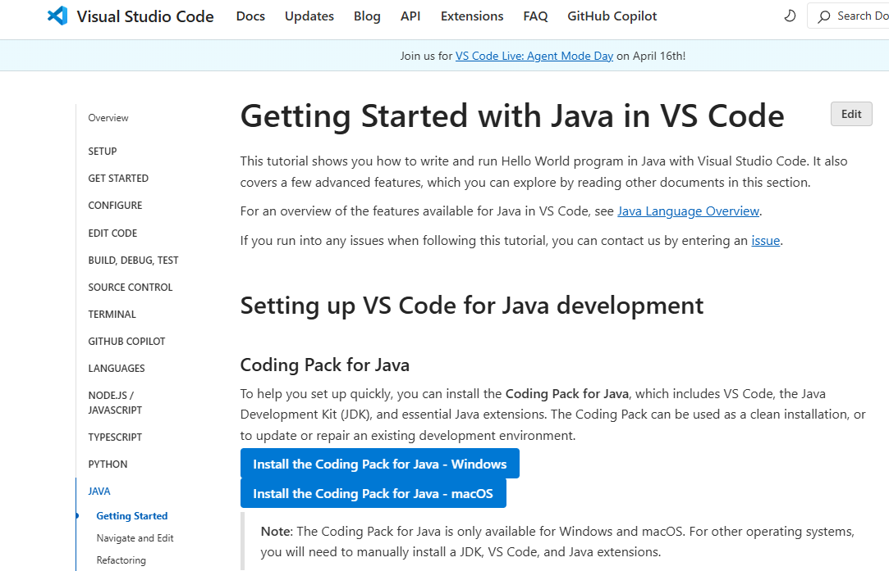
1
4
2
3

Slide 12
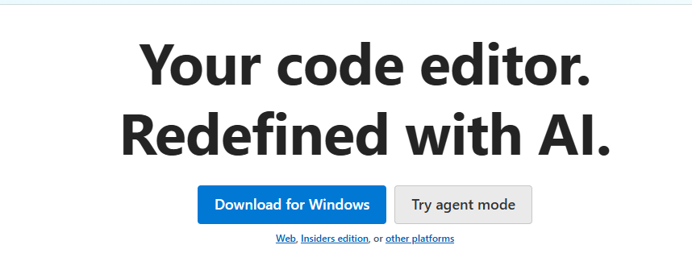
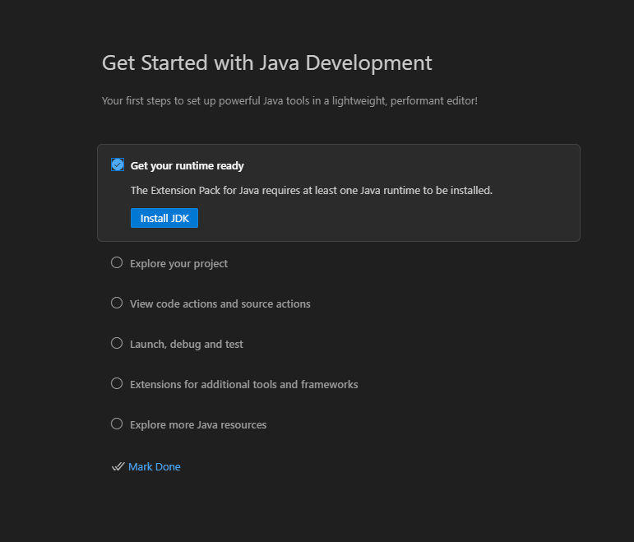
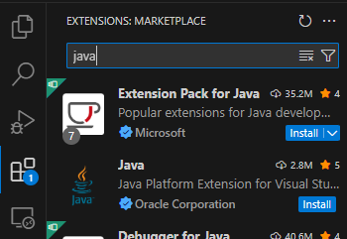
2
4
3
1

Slide 13
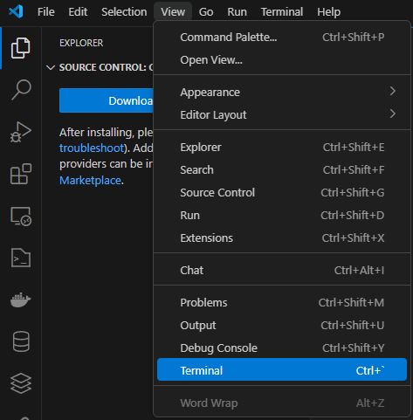
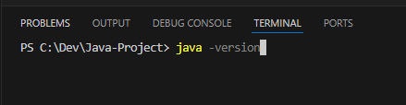
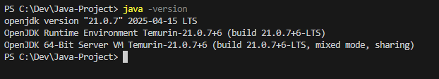
5
7
6
8

Slide 14
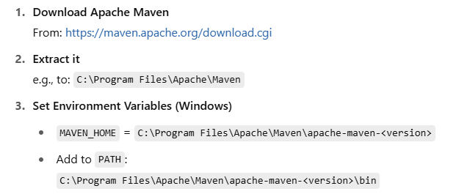
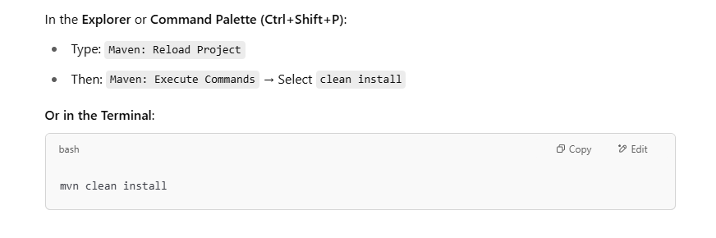

Slide 15
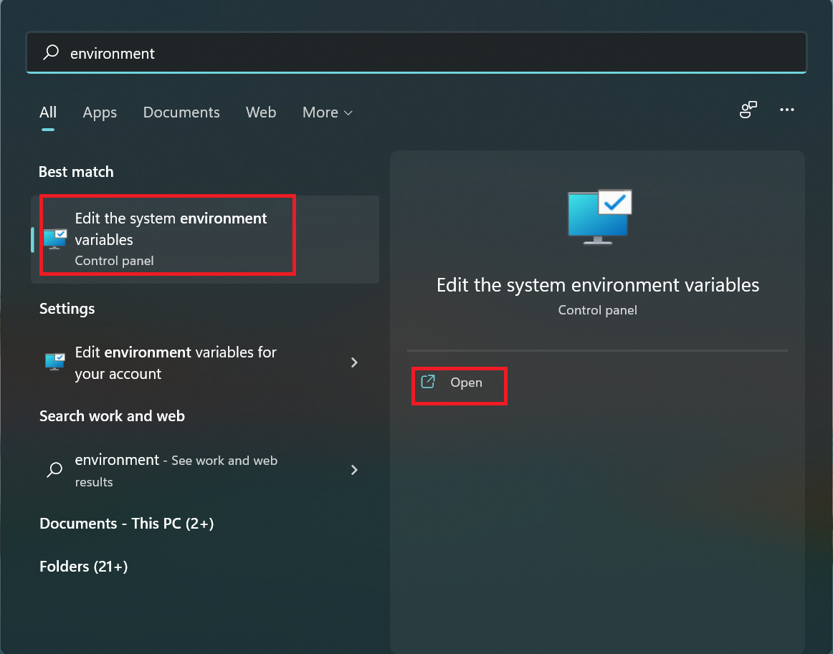

Slide 16
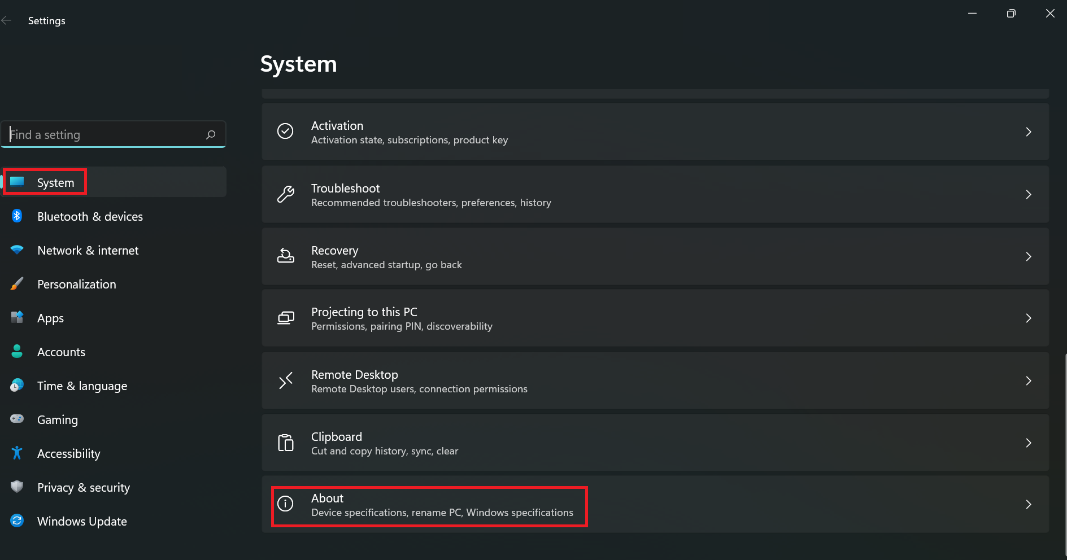

Slide 17
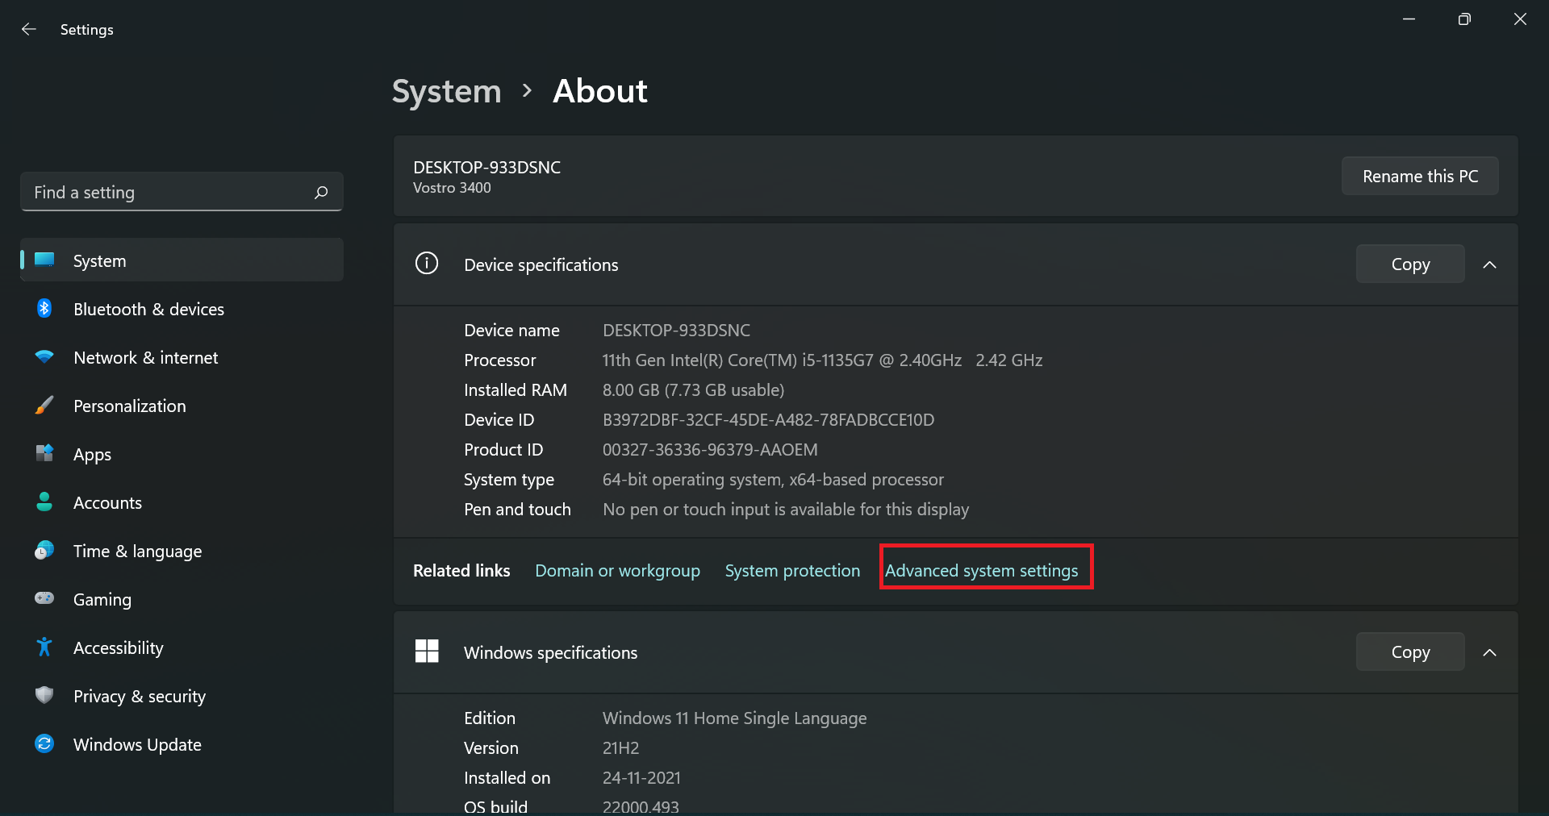

Slide 18
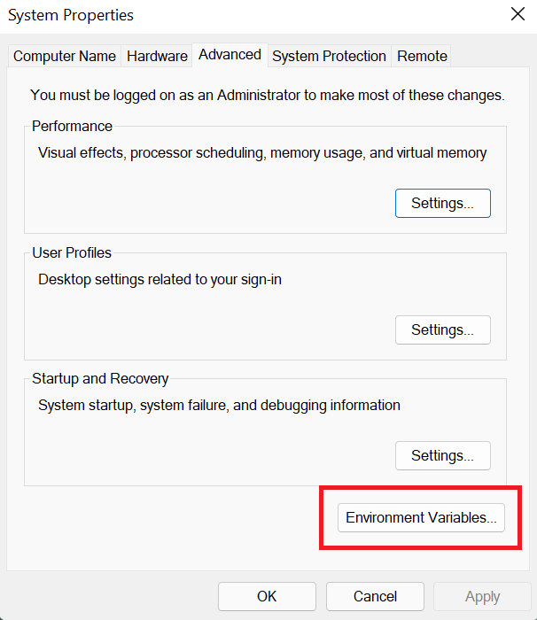
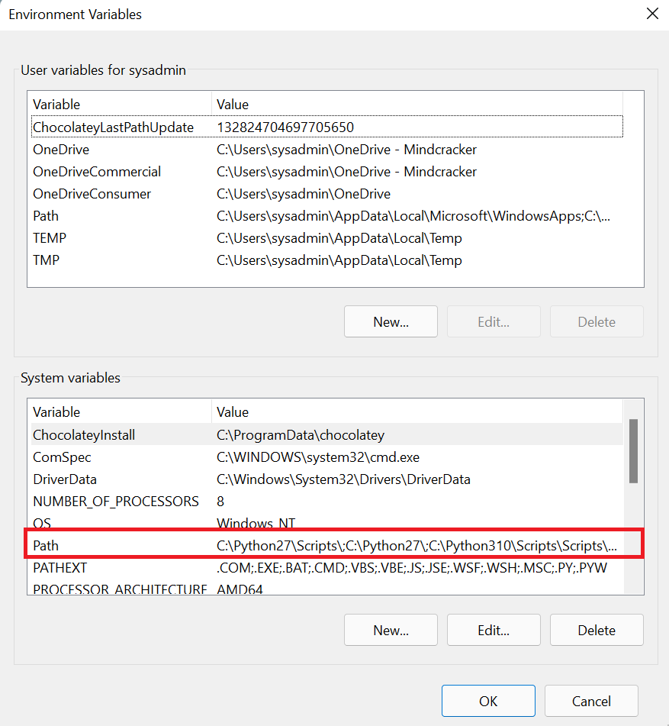

Slide 19
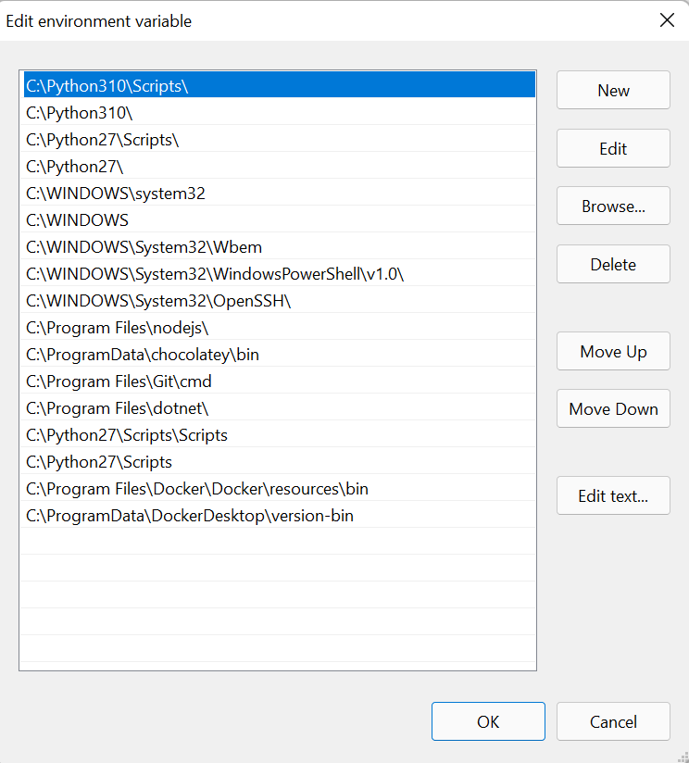

Slide 20
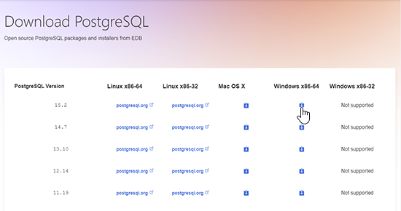
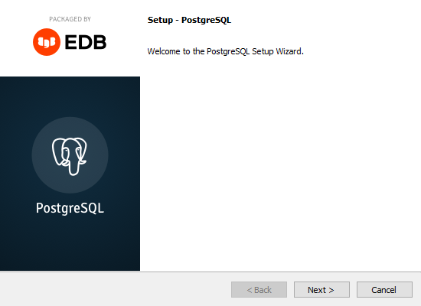
https://www.enterprisedb.com/downloads/postgres-postgresql-downloads
https://www.w3schools.com/postgresql/postgresql_install.php

Slide 21


Slide 22



Project Structure Overview
Maven Project
Standard Java project structure
Source Folders
/src/main/java for code
Resources
/src/main/resources for configuration files

Slide 23

Add Dependencies (pom.xml)
<dependencies>
<!-- https://mvnrepository.com/artifact/org.postgresql/postgresql -->
<dependency>
<groupId>org.postgresql</groupId>
<artifactId>postgresql</artifactId>
<version>42.7.4</version>
</dependency>
<!-- https://mvnrepository.com/artifact/org.hibernate/hibernate-core -->
<dependency>
<groupId>org.hibernate</groupId>
<artifactId>hibernate-core</artifactId>
<version>7.0.0.Beta3</version>
</dependency>
</dependencies>

Slide 24

hibernate.cfg.xml Configuration
<hibernate-configuration xmlns="http://www.hibernate.org/xsd/orm/cfg">
<session-factory>
<property name="hibernate.connection.driver_class">org.postgresql.Driver</property>
<property name="hibernate.connection.url">jdbc:postgresql://localhost:5432/payroll</property>
<property name="hibernate.connection.username">postgres</property>
<property name="hibernate.connection.password">1234567</property>
<property name="hibernate.hbm2ddl.auto">update</property>
<property name="hibernate.show_sql">true</property>
</session-factory>
</hibernate-configuration>

Slide 25

Mapping Entities
Entity Annotations
Field Annotations
@Entity marks Java class as entity
@Id marks primary key
@GeneratedValue for auto-increment
@Table specifies database table
Relationship Annotations
@OneToMany links related entities
@ManyToOne defines reverse relation

Slide 26








Bootstrap Hibernate
private static final SessionFactory sessionFactory = new Configuration()
.configure("hibernate.cfg.xml")
.addAnnotatedClass(Employee.class)
.addAnnotatedClass(Payroll.class)
.buildSessionFactory();
Load Configuration
Add Classes
Read hibernate.cfg.xml
Register entity classes
Ready
Build Factory
Hibernate initialized
Create SessionFactory

Slide 27
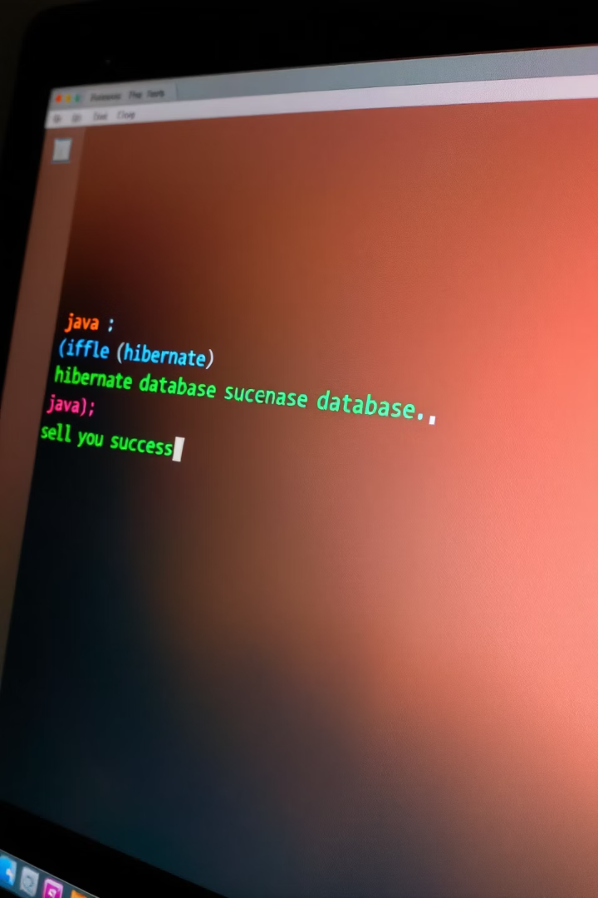



Test Hibernate Connection
Create Test Class
Main method to test connection
Open Session
Get session from factory
Verify
Print "Connected!" if successful

Slide 28
Why Create Object Classes?
Database Structure
Maps To
Java Structure
Tables
↔
Classes
Columns
↔
Fields
Relationships
Object references
↔

Slide 29
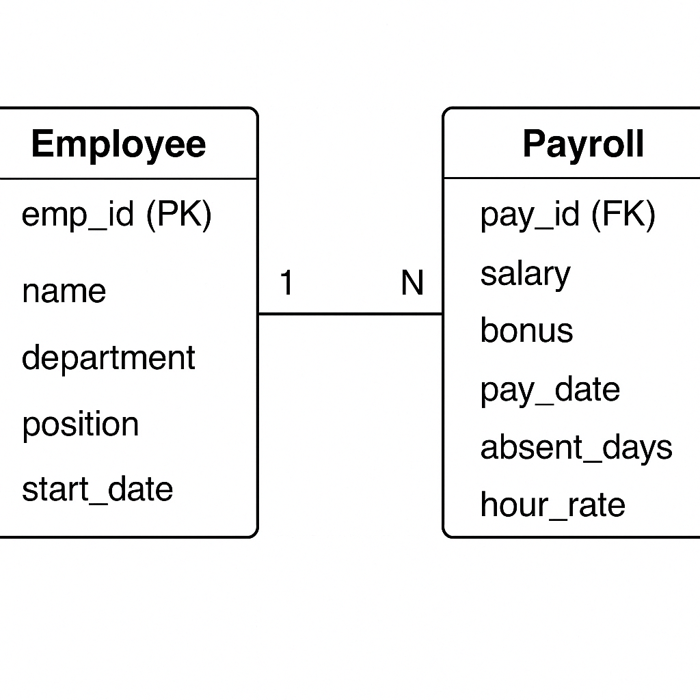

Slide 30

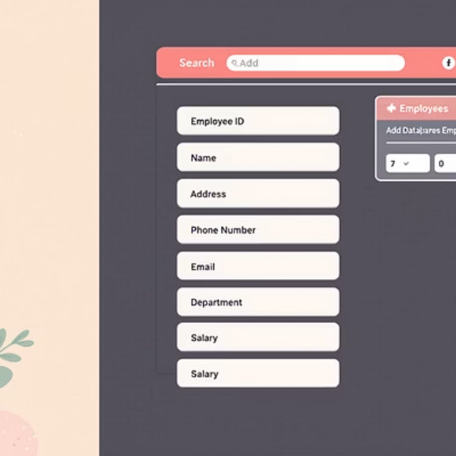
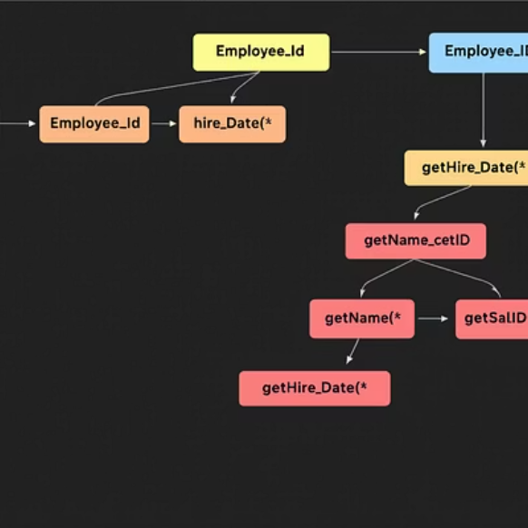
Employee Class
@Entity public class Employee { @Id @GeneratedValue private int empId; private String name; private String department; ... }

Slide 31

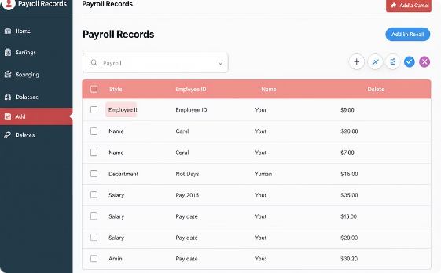
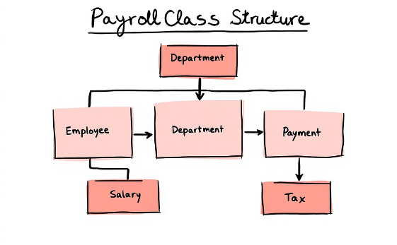
Payroll Class
@Entity public class Payroll { @Id @GeneratedValue private int payId; private double salary; ... }
Entity Class
Database Table
UML Design
Java class with annotations
Corresponding SQL table
Visual class representation

Slide 32



Use of Getters and Setters
JavaBean Standard
Getter Methods
Setter Methods
Follow established pattern for properties
getX() returns field value
setX() updates field value

Slide 33
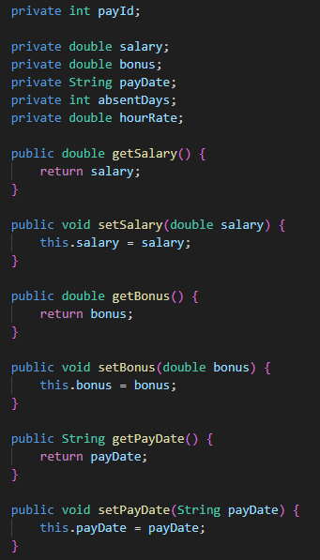
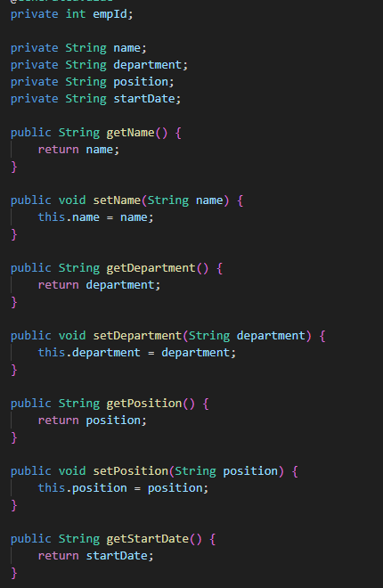

Slide 34







Entity Relationships
@ManyToOne private Employee employee;
@OneToOne
@OneToMany
One-to-one relationship
One-to-many relationship
@ManyToMany
@ManyToOne
Many-to-many relationship
3
Many-to-one relationship

Slide 35
Map Employee ↔ Payroll (1:N)
Employee Side
Payroll Side
@OneToMany(mappedBy="employee") private List payrollList;
@ManyToOne private Employee employee;

Slide 36
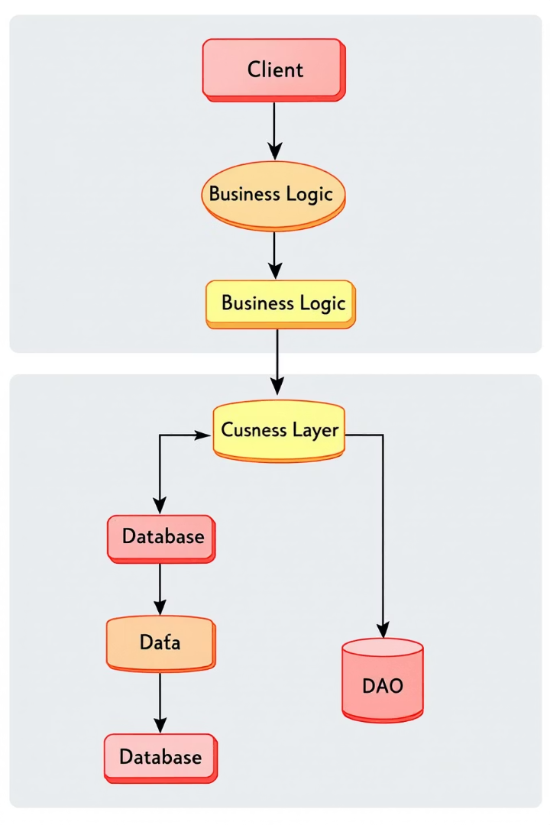
DAO Pattern
Data Access Object
Separation of Concerns
Encapsulates database operations
Isolates data access logic
Reusable Code
Centralizes database operations

Slide 37

Add Employee (DAO)
Create Object
Instantiate Employee with data
Open Session
Get Hibernate session
Save Object
session.save(employee);

Slide 38
public void addEmployee(String name, String department, String position, String startDate) {
Transaction tx = null;
try (Session session = HibernateUtil.getSessionFactory().openSession()) {
tx = session.beginTransaction();
// Step 1: Create Object
Employee employee = new Employee();
employee.setName(name);
employee.setDepartment(department);
employee.setPosition(position);
employee.setStartDate(startDate);
// Step 2: Save Object
session.persist(employee); // Use persist() or save()
tx.commit();
System.out.println("✅ Employee added: " + employee);
} catch (Exception e) {
if (tx != null) tx.rollback();
e.printStackTrace();
}
}

Slide 39




Delete Employee (DAO)
Find Employee
Locate by ID
Delete Object
session.delete(employee);
Commit Transaction
Save changes to database

Slide 40
public void deleteEmployeeById(int empId) {
Transaction tx = null;
try (Session session = HibernateUtil.getSessionFactory().openSession()) {
tx = session.beginTransaction();
// Step 1: Find
Employee emp = session.find(Employee.class, empId);
if (emp != null) {
// Step 2: Delete
session.remove(emp); // ✅ Hibernate 6+
System.out.println("✅ Employee deleted: " + empId);
} else {
System.out.println("⚠️ Employee not found: " + empId);
}
// Step 3: Commit
tx.commit();
} catch (Exception e) {
if (tx != null) tx.rollback();
e.printStackTrace();
}
}

Slide 41

List All Employees
List list = session.createQuery("from Employee").list();
1
2
Create Query
Execute Query
HQL query to select all employees
Get result list
3
Process Results
Iterate through employee objects

Slide 42
public void listAllEmployees() {
try (Session session = HibernateUtil.getSessionFactory().openSession()) {
// Step 1: Create Query (HQL)
String hql = "FROM Employee"; // HQL uses class name, not table name
List<Employee> employees = session.createQuery(hql, Employee.class).list();
// Step 2: Process Results
if (employees.isEmpty()) {
System.out.println("⚠️ No employees found.");
} else {
for (Employee emp : employees) {
System.out.println("🧑‍💼 " + emp);
}
}
} catch (Exception e) {
e.printStackTrace();
}
}

Slide 43


Add Payroll
Payroll p = new Payroll(...); session.save(p);
Create Payroll
New Payroll object with data
Open Session
2
Get Hibernate session
Save Record
Persist to database

Slide 44
public void addPayroll(double salary, double bonus, String payDate, int absentDays, double hourRate, Employee employee) {
Transaction tx = null;
try (Session session = HibernateUtil.getSessionFactory().openSession()) {
tx = session.beginTransaction();
// Step 1: Create Payroll Object
Payroll payroll = new Payroll();
payroll.setSalary(salary);
payroll.setBonus(bonus);
payroll.setPayDate(payDate);
payroll.setAbsentDays(absentDays);
payroll.setHourRate(hourRate);
// Associate with employee
payroll.setEmployee(employee);
// Step 2: Persist to DB
session.persist(payroll);
tx.commit();
System.out.println("✅ Payroll added: " + payroll);
} catch (Exception e) {
if (tx != null) tx.rollback();
e.printStackTrace();
}
}

Slide 45
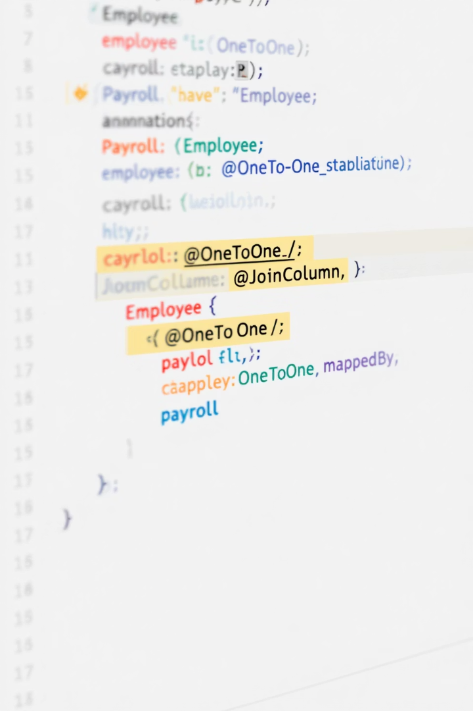



Set Payroll to Employee
payroll.setEmployee(employee); employee.getPayrollList().add(payroll);
Link Objects
Connect both sides of relationship
Save Changes
Persist updated objects
Verify
Confirm relationship established

Slide 46
public static void main(String[] args) {
try (Session session = HibernateUtil.getSessionFactory().openSession()) {
Transaction tx = session.beginTransaction();
// Re-fetch employee in the same session
Employee emp = session.find(Employee.class, 1);
if (emp != null) {
Payroll payroll = new Payroll();
payroll.setSalary(25000);
payroll.setBonus(3000);
payroll.setPayDate("2025-04-30");
payroll.setAbsentDays(2);
payroll.setHourRate(150.0);
emp.addPayroll(payroll); // No LazyInitializationException
session.merge(emp);
tx.commit();
System.out.println("✅ Payroll added for employee ID: " + emp.getEmpId());
}
}
}

Slide 47
SELECT table_schema, table_name
FROM information_schema.tables
WHERE table_type = 'BASE TABLE'
AND table_schema NOT IN ('pg_catalog', 'information_schema');
select * from employee;
select * from payroll;

Slide 48
Cascade and Fetch Types
Cascade Types
Fetch Types
CascadeType.ALL
FetchType.LAZY
CascadeType.PERSIST
FetchType.EAGER
CascadeType.REMOVE

Slide 49







Transaction Management
Transaction tx = session.beginTransaction(); // operations tx.commit();
Begin
Operate
Start transaction
2
Perform database operations
Rollback
Commit
Revert on error
Save changes permanently

Slide 50
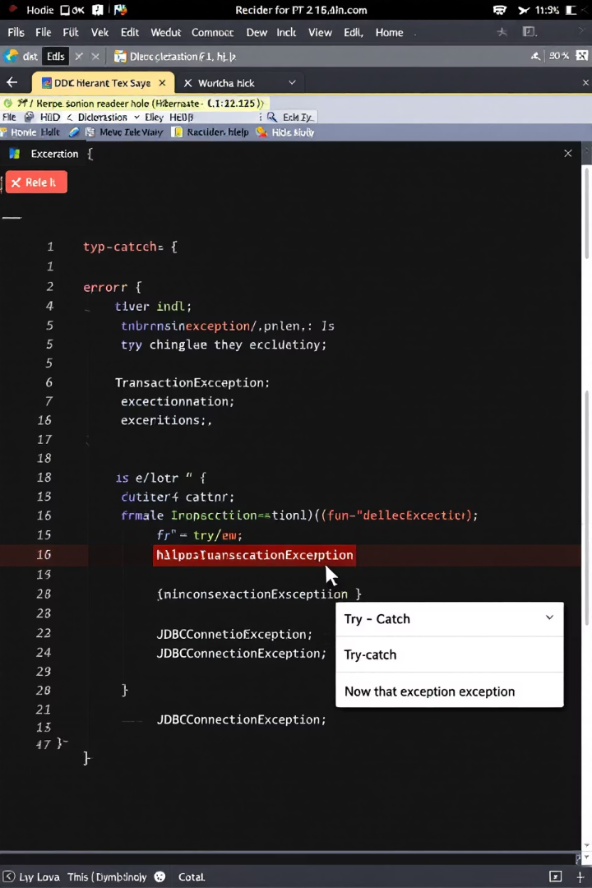
Error Handling
try { // Hibernate operations } catch (Exception e) { e.printStackTrace(); }
Try Block
Attempt database operations
Catch Exceptions
Handle specific error types
Rollback Transaction
Revert changes on error

Slide 51
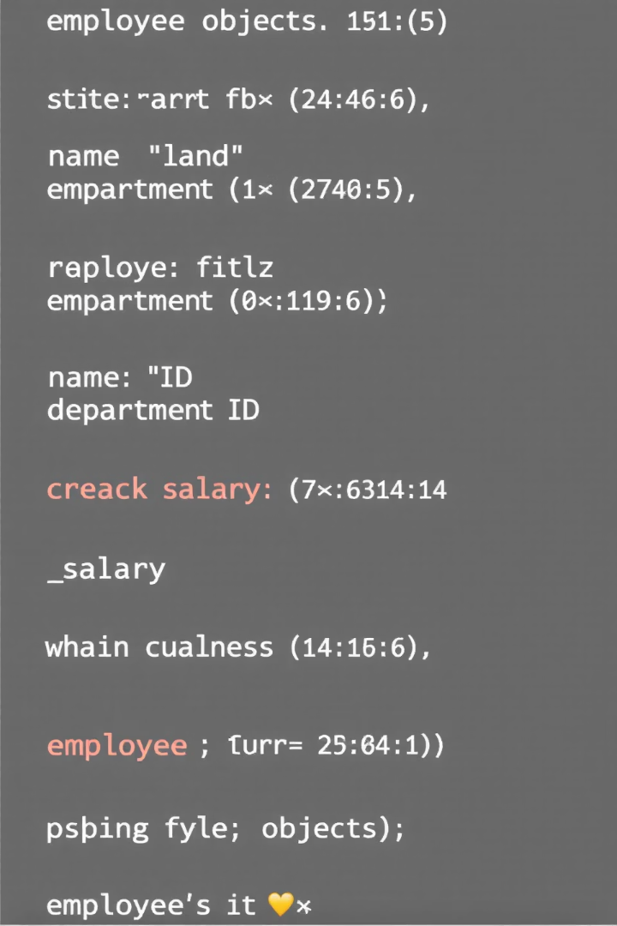



Method: print_List()
public void printList() { for (Employee e : employees) System.out.println(e); }
Iterate Collection
Print Each Item
Loop through employee list
Display employee details
Console Output
View results in terminal

Slide 52




Method: set_Payroll()
public void setPayroll(Employee e, Payroll p) { p.setEmployee(e); }
Employee Parameter
Payroll Parameter
Association
Connect objects via reference
Target employee object
Payroll record to associate

Slide 53

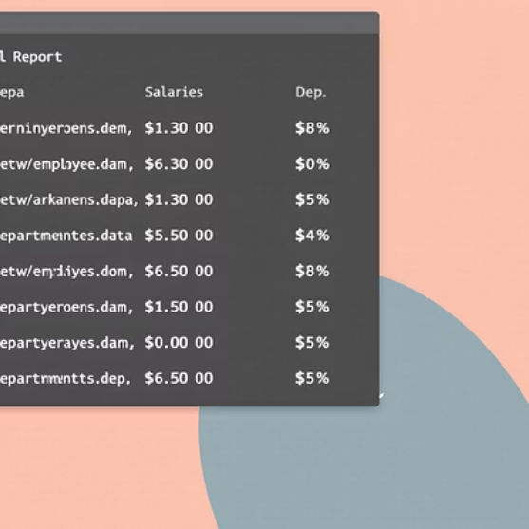
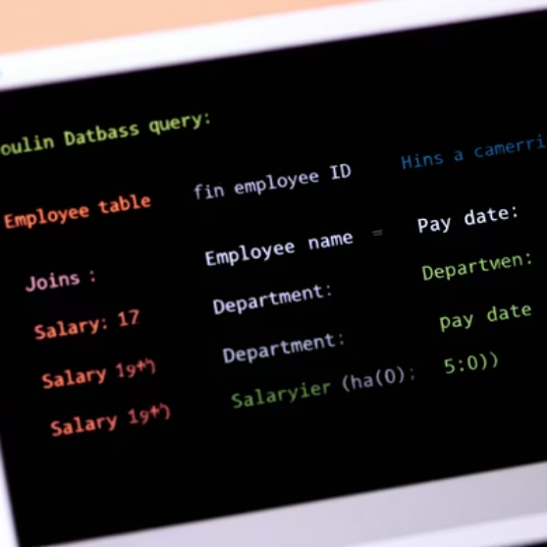
Method: print_Result()
Combine Objects
Format Output
Display Results
Show employee with payroll
Present data clearly
Print to console

Slide 54
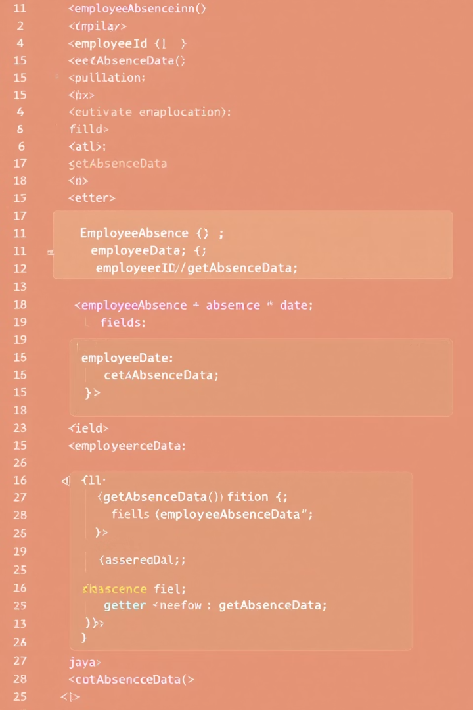
Method: get_Absent()
return this.absentDays;
1
2
Method Purpose
Implementation
Retrieve absence data
Simple getter method
3
Usage
Calculate attendance metrics

Slide 55
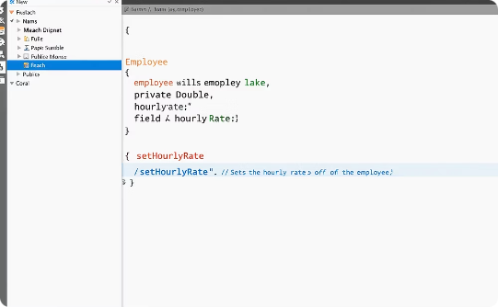

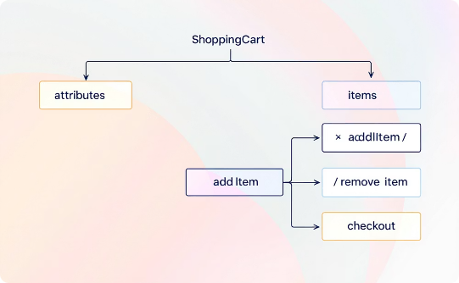
Method: set_hour_rate()
this.hourRate = rate;
Method Code
Business Context
Design View
Simple field assignment
Used in payroll calculations
Part of Payroll class

Slide 56
Method: get_hour_rate()
return this.salary / totalHours;

Slide 57
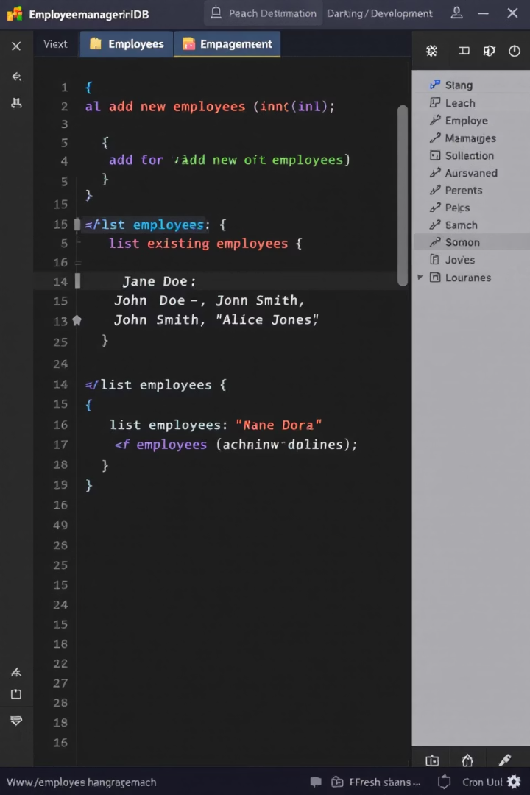



Exercise 1: Add & List
Create Employees
Save to Database
Add 3 employee objects
Persist using Hibernate
List Results
Print employees to console

Slide 58





Exercise 2: Payroll Assignment
Create Payroll Records
Generate payroll objects
Assign to Employees
Link payroll to employee
Save Relationships
Persist changes to database
Print Results
Show employee-payroll connections

Slide 59




Exercise 3: Deletion
Find Employee
Locate by ID
Delete Record
Remove from database
Verify Deletion
Confirm using print_List

Slide 60
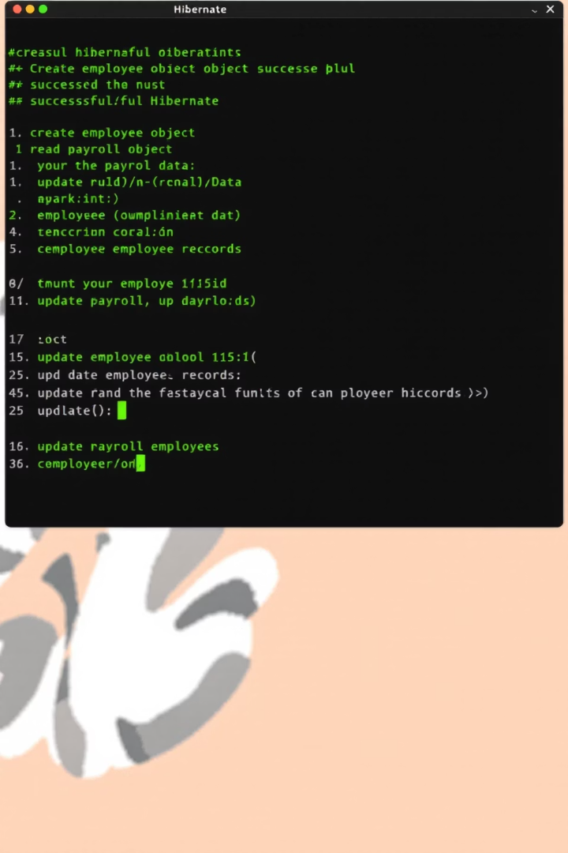
Sample Output Screenshot
Console Log
Success Messages
Shows operation results
Confirms database operations
Data Display
Shows retrieved objects

Slide 61
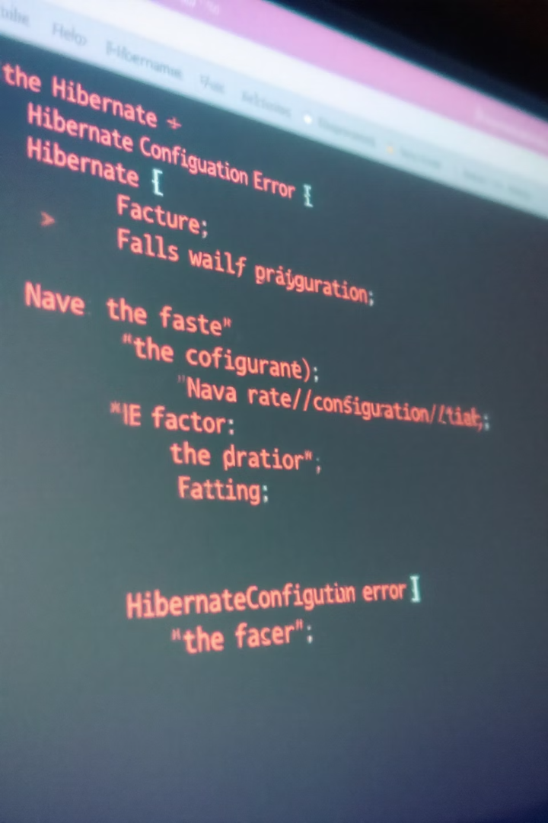



Common Errors
No Dialect
SessionFactory Issues
XML Tag Errors
Missing database dialect setting
Malformed configuration files
Configuration or connection problems
Mapping Problems
Incorrect entity annotations

Slide 62
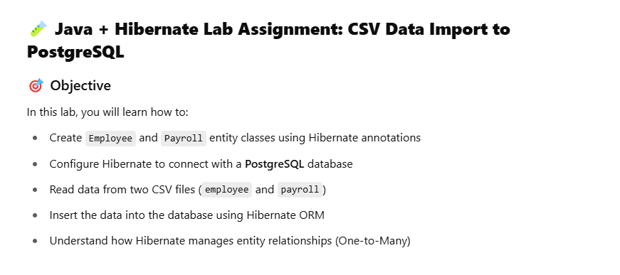
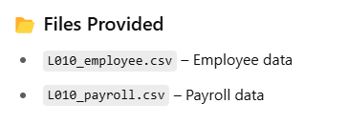

Slide 63
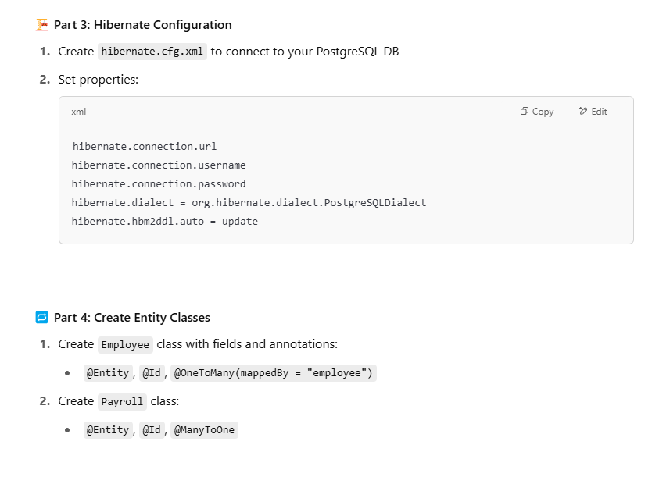
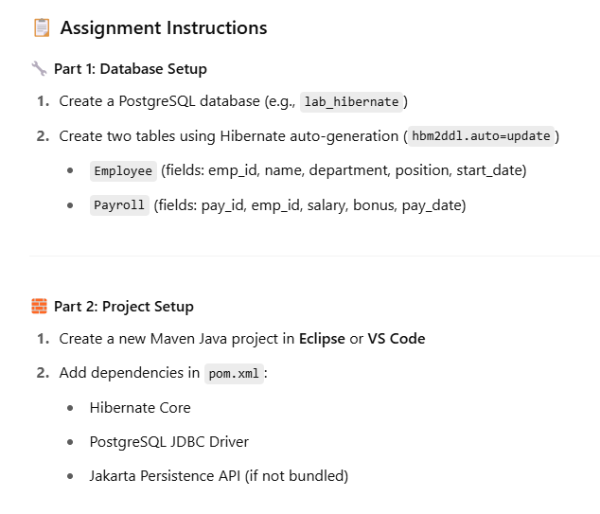

Slide 64
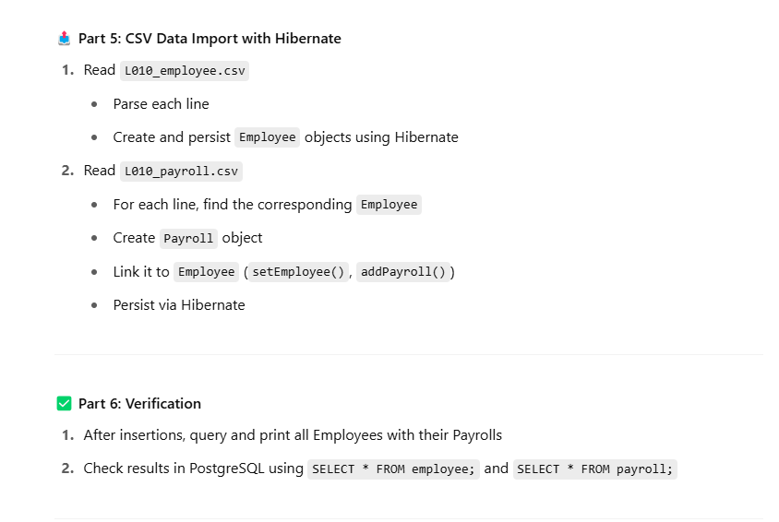

Slide 65
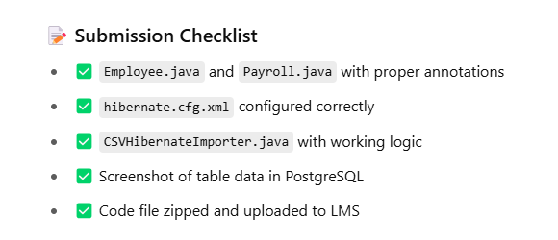

Slide 66
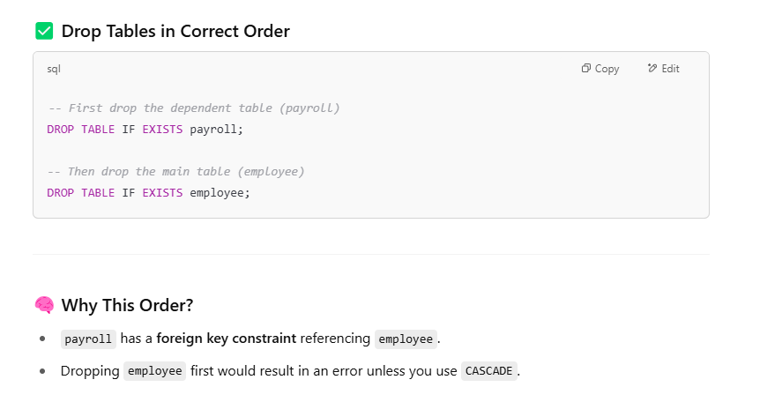

Slide 67






Summary & Q/A
Hibernate ORM
Object Mapping
Object-relational mapping framework
1
2
Java classes to database tables
Questions?
Payroll App
Discussion and clarification
Practical database application

